Slide 1
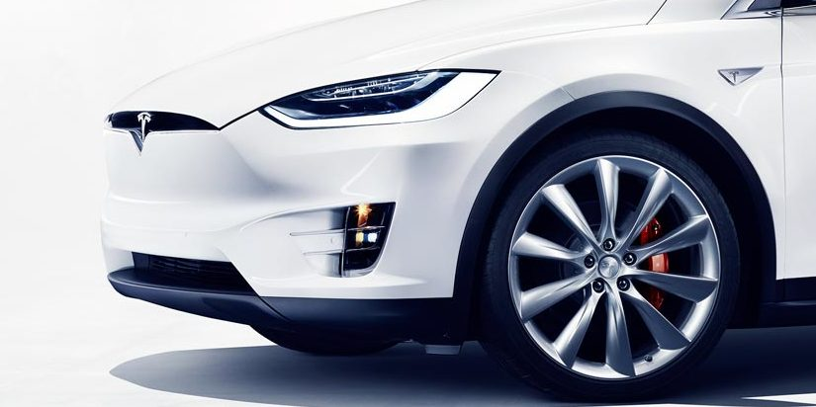
Internet of Things : Vehicular Clouds
Presented By Group 16 : Ruifeng Luo, Wuang Shen, Tiange Wang

Slide 2
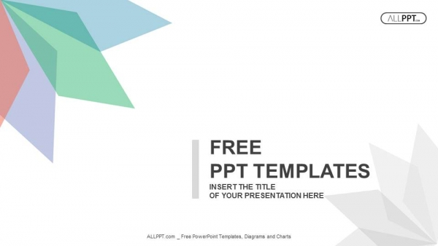
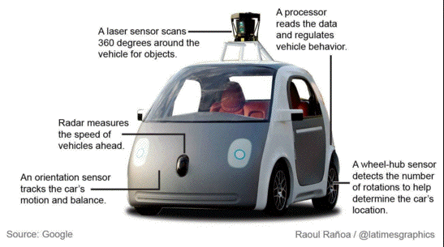
About autonomous vehicle
IoT?
Related to self-driving car?

Slide 3
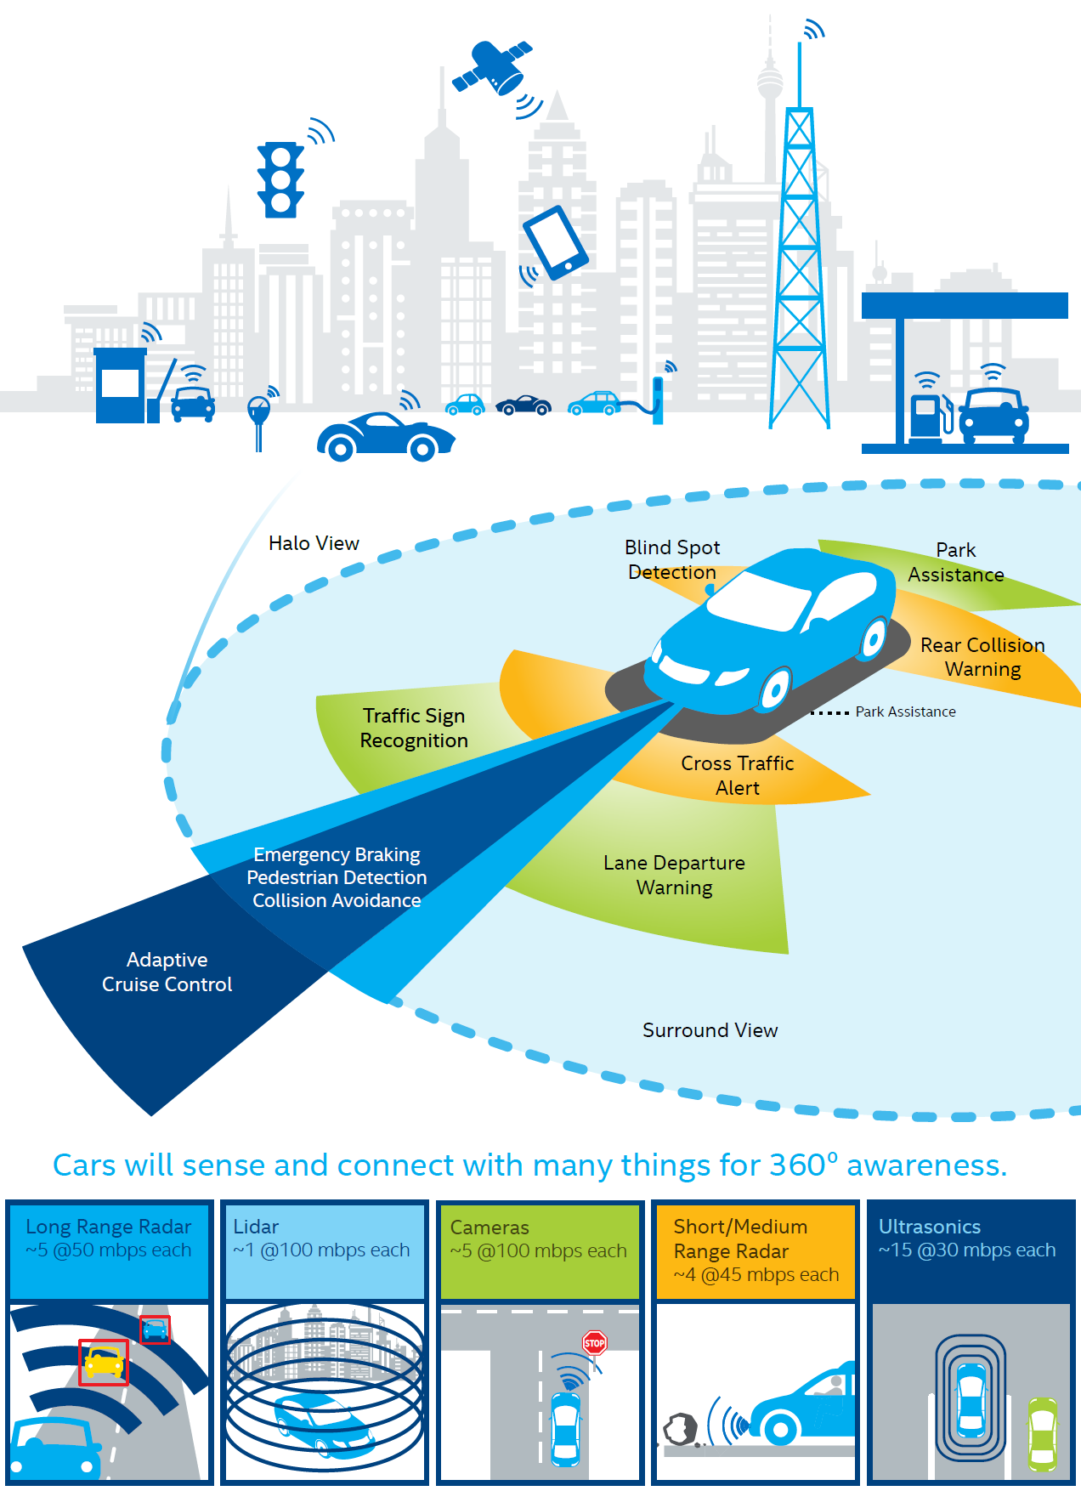
IoT and self-driving car
Based on cloud
Challenges exists
Analysis of security to threats

Slide 4
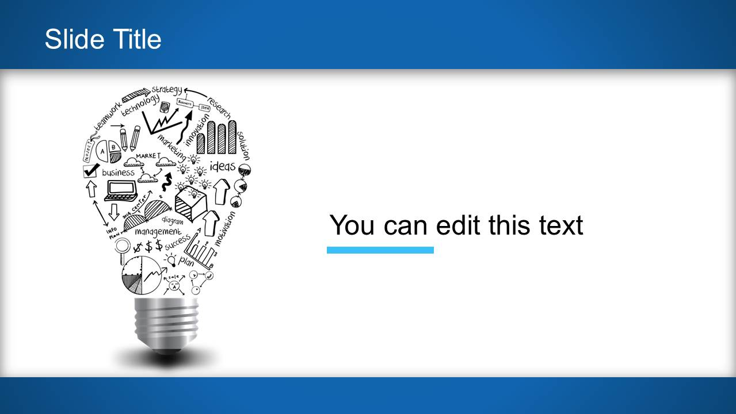
Challenges?
Confidentiality
Other
Self-drive car
Based on cloud
Authentication
Integrity

Slide 5
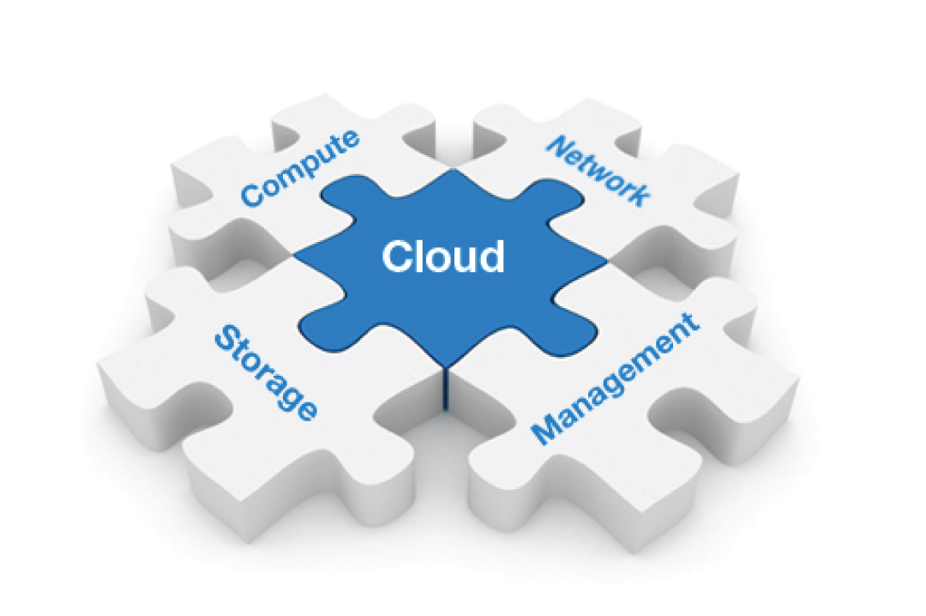
Solutions for challenges
Data leakage: AES algorithm
Cloud provider's identity: Key distribution system
Information not be modified: TLS

Slide 6

Limitations
The key distribution depends on protocols.
TLS requires additional equipments.

Slide 7

Development
Challenges
Solutions
The self-driving car technique is still not mature.

Slide 8
Reference
Electronicproducts.com. (2017). AES vs SSL/TLS: Encryption for the internet of things - Electronic Products. [online] Available at: https://www.electronicproducts.com/Computer_Peripherals/Communication_Peripherals/AES_vs_SSL_TLS_Encryption_for_the_internet_of_things.aspx [Accessed 11 Oct. 2017].
Gerla, M., Lee, E., Pau, G. and Lee, U. (2014). Internet of vehicles: From intelligent grid to autonomous cars and vehicular clouds. 2014 IEEE World Forum on Internet of Things (WF-IoT).
HIPAA News, Web & Email Security Tips & News - Plus More | LuxSci. (2017). SSL versus TLS – What’s the difference?. [online] Available at: https://luxsci.com/blog/ssl-versus-tls-whats-the-difference.html [Accessed 11 Oct. 2017].
Pawar, A. and Ghumbre, S. (2016). A survey on IoT applications, security challenges and counter measures. 2016 International Conference on Computing, Analytics and Security Trends (CAST).
Sklavos, N. and Zaharakis, I. (2016). Cryptography and Security in Internet of Things (IoTs): Models, Schemes, and Implementations. 2016 8th IFIP International Conference on New Technologies, Mobility and Security (NTMS).
Yeshodara, N., Nagojappa, N. and Kishore, N. (2014). Cloud Based Self Driving Cars. 2014 IEEE International Conference on Cloud Computing in Emerging Markets (CCEM).

